Slide 1
Holy Family STEM
November 4, 2016

Slide 2
Agenda
Mechanical advantage
  Lever ratio
  Gears
  Gears as levers
Today’s build

Slide 3
Levers
Simple levers all around us
Basic length to force ratio
  1 to 1
    Distance to fulcrum is equal
    Forces are equal
    Movement is equal
  2 to 1
    Distance to fulcrum is twice as much
    Lift force is twice as much as push force
    Push movement is twice of lift
  10 to 1

Slide 4
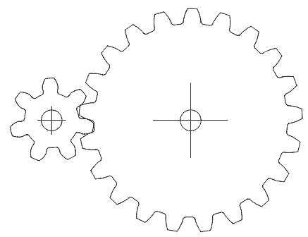
Gears
Gears are levers that move in a circle
The ratio of the diameters determines the reduction ratio

Slide 5
Today’s Build
Create mechanical advantage of at least 3 to 1
Your choice of method
End of day:
  What worked?
  What didn’t?
  What happened to the beams as the load increased?
  What goes in your notes?

